Slide 1
Dissolution of partnership firm

Slide 4
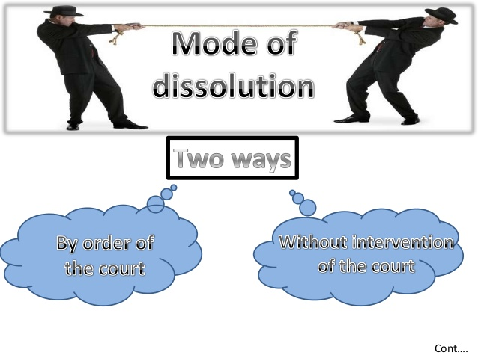

Slide 5
ACCOUNTING TREATMENT OF DISSOLUTION
On dissolution of a firm, the following accounts are opened to close the books of the firm.
· Realisation Account;
· Partner’s Loan Account;
· Partner’s Capital Accounts; and
· Cash or Bank Account.

